Slide 1
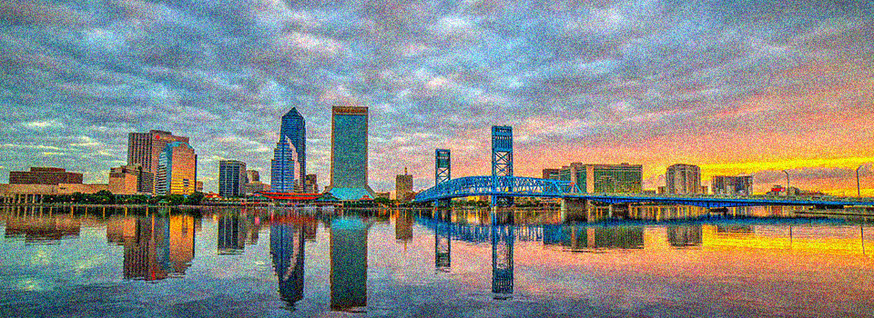
City of Jacksonville: Presentation to Charter Revision Commission Subcommittees:
Strategic Planning/Urban Services District
December 6, 2019

Slide 2
Strategic Partnerships Background and Goals
Mayor’s Non-Profit Interface Sub-Committee
New municipal strategy: similar offices exist including Denver, Newark, Oakland, Boston, Durham, Fairfax VA, Los Angeles, and Minneapolis.
Modeled after private-sector corporate social responsibility.
Develop strategic partnerships between nonprofits, philanthropy and City of Jacksonville to leverage opportunities, align efforts and facilitate better opportunities for Jacksonville’s citizens.
Identify best practices and technological and operational efficiencies to increase community impact.

Slide 3
Steering Committee Representation and Objectives
Representation:
Arts & Culture Human Services Healthcare
Community Neighborhoods Education
Philanthropy Faith Private Sector
Objectives:
Promote mutual understanding and collaboration between city government, nonprofits and philanthropy and identify strategic opportunities for partnerships.
Serve as a trusted source of data, information and dialogue about programs and policy impacts.
Facilitate strategic joint investments that will improve outcomes for Jacksonville and its citizens.

Slide 4
Recent Accomplishments
Disaster Preparation, Response and Recovery
Long-term Recovery Organization
First Coast Relief Fund
International Philanthropy
Mayor’s Downtown Homeless Taskforce
Urban Rest Stop
Mobile Medical and Service Buses
Mayor’s Youth at Work Partnership
Career-Pathways for Youth; KHA Essential Services Plan
Nonprofit Capacity Building
Nonprofit Gateway
COJ Town Halls/COJ Philanthropic Roundtable

Slide 5
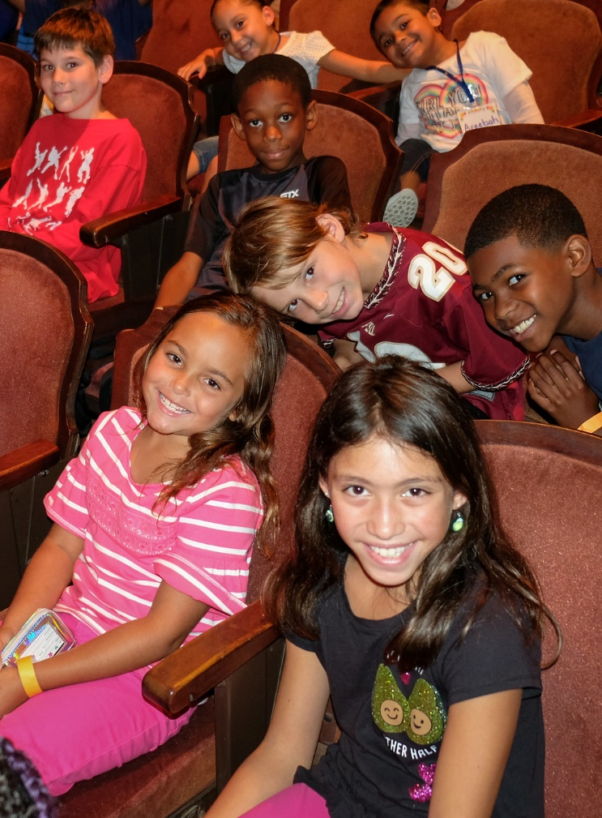
Next Steps
Strategic Partnerships Steering Committee 1-3-5 year Strategic Plan
Inventory of successful partnerships.
Expansion of coordinated intake and case management.
Alignment of public, private and philanthropic strategies, metrics and outcomes.

Slide 6
Contact Info
Dawn Lockhart
Director of Strategic Partnerships
904-255-5007
dlockhart@coj.net
Sarah Green
Strategic Partnerships Coordinator
904-255-5021
sarahg@coj.net

